Slide 1

COVID-19
National Case Tracker — CSCE 413 Final Project
Presented By: Christian Berck, Easton Joachimsen, Ryan Le, & Matt Sichterman
Notes:
Ryan Le

Slide 2
GOALS
Primary Goals
Visualize COVID cases as they rise throughout the US
Analyze trends and showcase which states have been most susceptible to the coronavirus
Determine areas most impacted by the pandemic
Secondary Goals
Visualize potential relationships between state governors’ party affiliations and COVID cases over time
Notes:
Ryan Le

Slide 3
01.
02.
DATA SET
DATABASE DESIGN
03.
04.
FUNCTIONALITY
IMPLEMENTATION
Discussion of the John-Hopkins COVID-19 data and other supplemental data that we utilized
Breakdown of our database model and decisions made
Functions to give users insight into our data set
How and why we implemented an end-to-end web application
Notes:
Ryan Le

Slide 4
01.
DATA SET
Discussion of the John-Hopkins COVID-19 data and other supplemental data that we utilized
Notes:
Ryan Le

Slide 5
DATA SET OVERVIEW
Utilized the data from https://data.world/associatedpress/johns-hopkins-coronavirus-case-tracker
Data included time series data of cases and deaths by states, county level confirmed cases, and time series data of cases and deaths by county
Leveraged the the time series data of cases and deaths by state
Only leveraged general information about counties
Limited the time frame of our data between July 1, 2020 and November 3, 2020 in order to have a more manageable data set.
Supplemented our COVID-19 data with governor information per state and their political parties
Notes:
Ryan Le

Slide 6
02.
DATABASE DESIGN
Breakdown of our database model and decisions made
Notes:
Easton

Slide 7
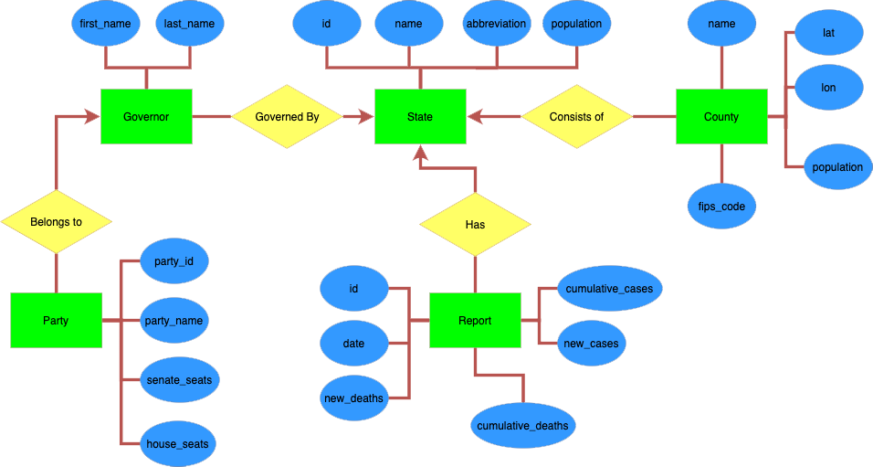
ER DIAGRAM
Notes:
Easton

Slide 8
DESIGN DECISIONS
Needed to separate our data into groups of tables rather than a mega table as depicted in the spreadsheet
There were clear groups of data including States, Counties, Reports, and Governors, all relating back to the root State table
Normalized the data, reduced data reduncies, and created these relationships between our four tables
To continue normalizing the data, we broke our governors table into two tables: Governor and Party.
This normalizes the data and allows us to avoid storing duplicate information for each governor (political party, senate seats, and house seats).
Thus, our five tables: State, County, Report, Governor, and Party
Notes:
Easton

Slide 9
03.
FUNCTIONALITY
Three functions to give users insight into our data set
Notes:
Christian

Slide 10
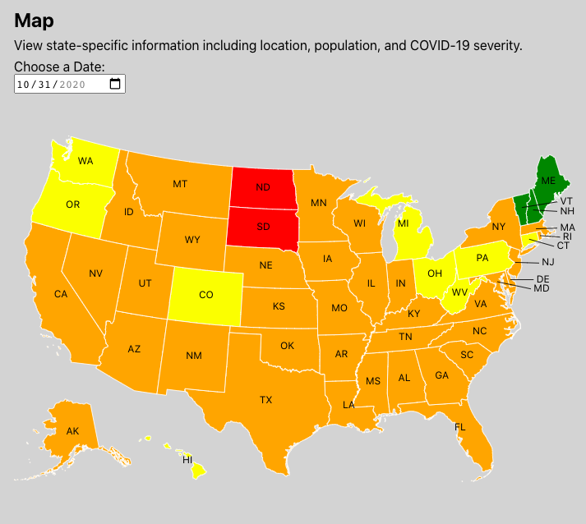
1. Given a date, get state information to populate the map and later calculate the amount of covid cases for each states’ population (as a percentage)
Query:
SELECT states.id, states.name, states.population, states.abbreviation, reports.cumulative_cases FROM states
INNER JOIN reports ON states.id = reports.state_id
WHERE reports.date = '2020-10-31'
Description:
Returns data for each state used to visualize a national view of COVID-19 severity for states based on their percentage of population with reported cases for the selected date.
Notes:
Christian

Slide 11
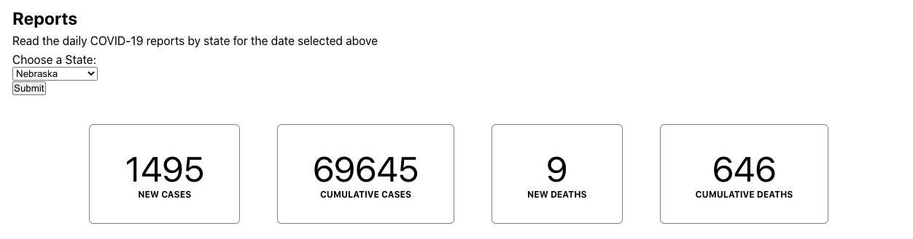
2. Given a state and a date, get the report including COVID-19 cases and deaths
Query:
SELECT cumulative_cases, new_cases, cumulative_deaths, new_deaths
FROM reports
WHERE state_id = 27 and date = '2020-10-31'
Description:
Returns the report data for the selected state and date, and is then visualized numerically in the web application (uses the same date as selected in the map section).
Notes:
Christian

Slide 12
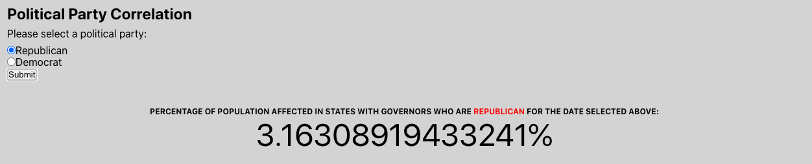
3. Given a political party, get the amount of covid cases for the population (as a percentage)
Query:
SELECT (
SELECT CAST(SUM(cumulative_cases) AS FLOAT)
FROM reports
WHERE date = '2020-10-31'
AND state_id IN (SELECT state_id FROM governors WHERE party_id = 1)
) / (
SELECT CAST(SUM(population) AS FLOAT)
FROM states
WHERE id IN (SELECT state_id FROM governors WHERE party_id = 1)
) * 100
Description:
Returns a percentage of COVID-19 cases for the population of states with governors who are the selected political party. Also uses the date selected in the Map section.
Notes:
Christian

Slide 13
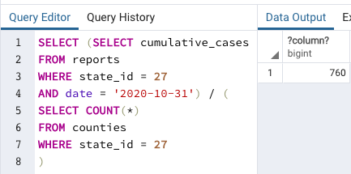
4. Given a state and a date, what are the average cases per county (not shown in our web app)
Query:
SELECT ( SELECT cumulative_cases
FROM reports
WHERE state_id = 27
AND date = '2020-10-31'
) / (
SELECT COUNT(*)
FROM counties
WHERE state_id = 27
)
Description: In order to utilize the counties table, this query takes a state and a date and computes the (approximate) amount of cases per county. This query was not implemented in the web application, but serves as a proof of concept for future work.
Notes:
Christian

Slide 14
04.
IMPLEMENTATION
https://csce-413.msich.dev/
How and why we implemented an end-to-end web application
Notes:
Easton - demo

Slide 15
Overview
Utilize modern technologies to showcase topics learned in class
React frontend
Node.js (via Express.js) API
PostgreSQL database
Leverage COVID-19 time series data in order to show trends over time
Use various queries to give our users the ability to control visualizations and gain meaningful insights
Notes:
Matt

Slide 16

PostgreSQL
PostgreSQL is a free and open source relational database management tool.
After normalizing the data, we loaded each CSV file as a separate data table and established relationships and foreign keys between the tables.
From there, we integrated our database to our React application using server-side technologies such as Express and Node.js as an API layer between our front-end application and our PostgreSQL database.
Notes:
Matt

Slide 17

Express.js
Express is a backend web application framework for Node.js that allows for building APIs.
Our team used Express to build the API to communicate between our React front-end and our PostgreSQL database.
Notes:
Matt

Slide 18

React
React is an open-source front-end library for building user interfaces in JavaScript that has become the industry standard.
React made it easier for our time to quickly package and build our web application, and was a technology that everyone on our team had prior experience with.
Using our React front-end, users can define their search to be submitted to our API and thus rerender the page based on their selections to show them meaningful COVID insights.
Notes:
Matt

Slide 19
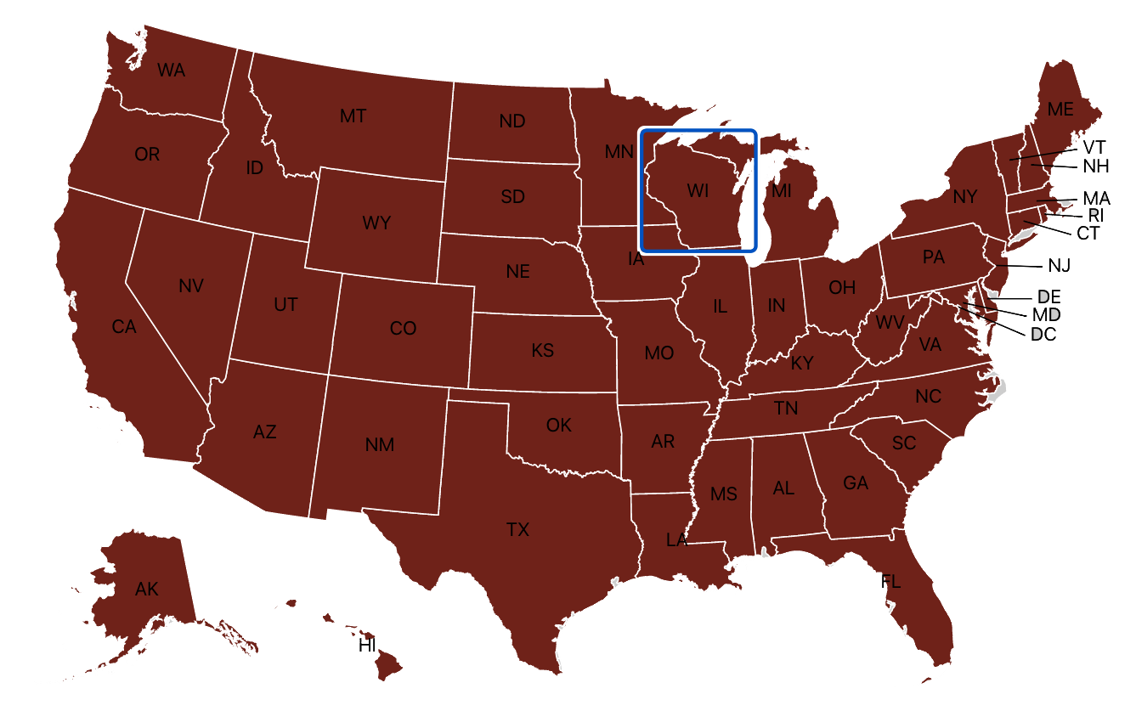
React Simple Maps
https://www.react-simple-maps.io/examples/usa-with-state-labels/
React Simple Maps is a declarative scalable vector graphic creation library for visualizing map interactions within a React component.
This library allows us to create an interactive user experience in displaying and analyzing COVID data across the country.
Notes:
Matt

Slide 20
THANKS!
Any questions?

